Slide 1
Grassroots Preservation: A Case Study
Denver’s ‘Owner-Opposed’ Landmark Designation Experience

Slide 2
Key Objectives
Organizing a Grassroots Campaign
Understanding & Navigating the Process
The Importance of “Institutional” Help
The Need for Skillset Diversity

Slide 3
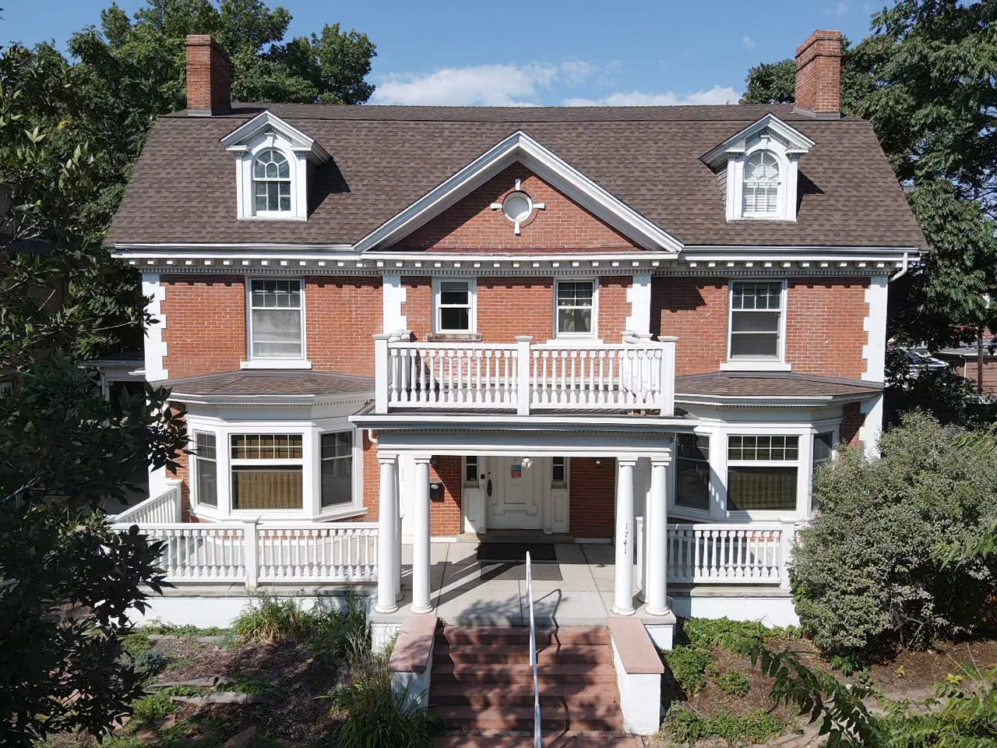
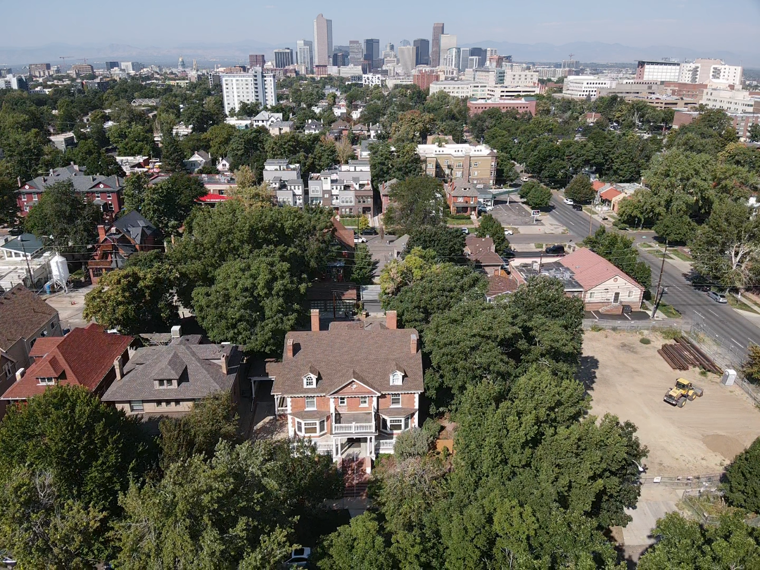
Overview of Landmark Process
1902/3 Mansion in Denver’s City Park West neighborhood
Developer purchased to obtain part of the lot for adjacent project, decided to demolish as well for new project
City examines all demo applications to see if any meet min 3/10 Landmark criteria (DOI’s standards)
If so, public notice (sign) posted giving interested parties 2 weeks to submit “Notice of Intent” letter seeking Landmark status
Triggers mediation. If that does not result in an agreement, an “Owner-Opposed” Landmark application can be submitted.
Package goes thru City Landmark staff, then to Landmark Preservation Commission, then one sub-group of City Council, then full City Council hearing for final determination

Slide 4
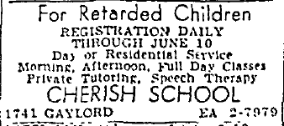
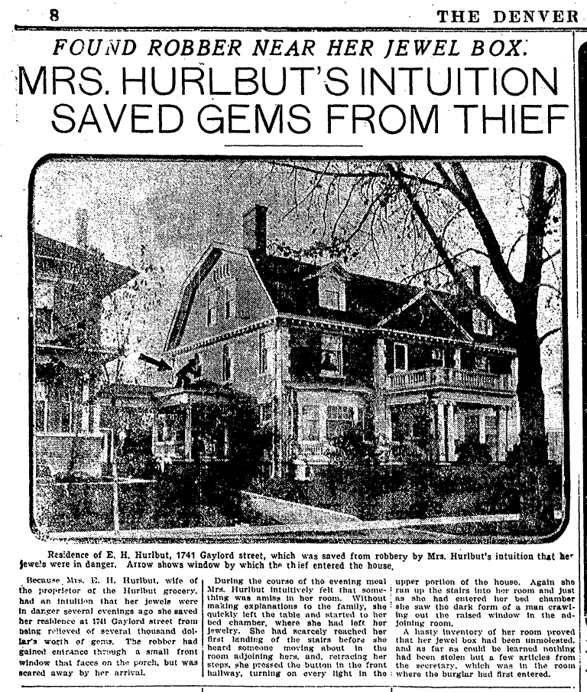
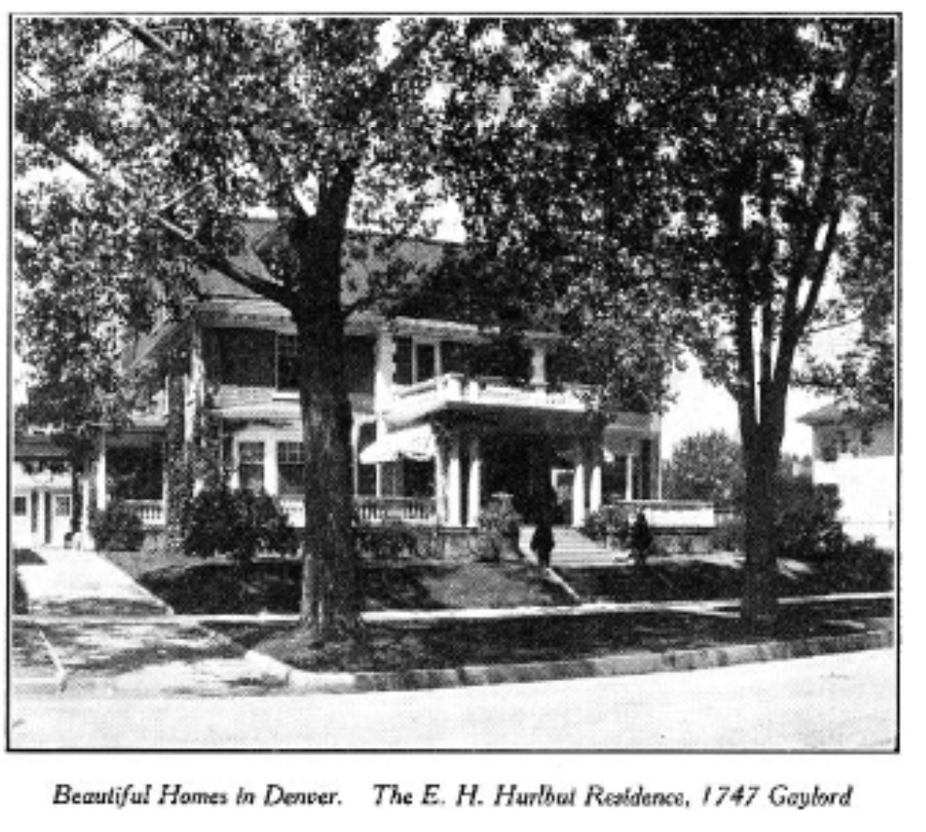
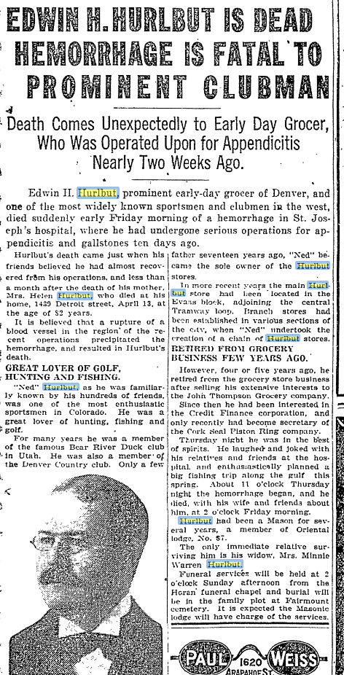
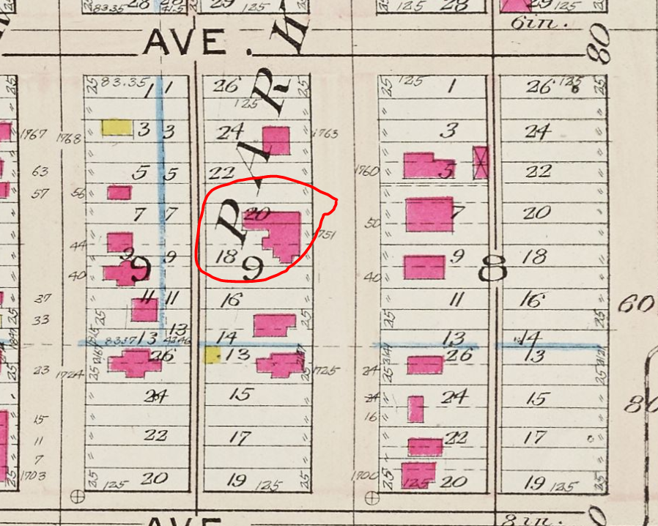
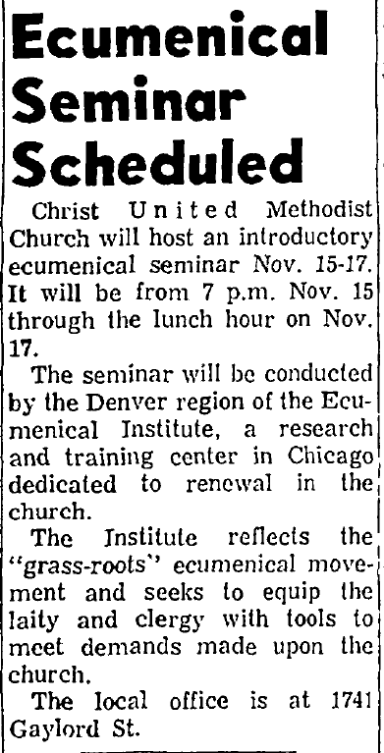
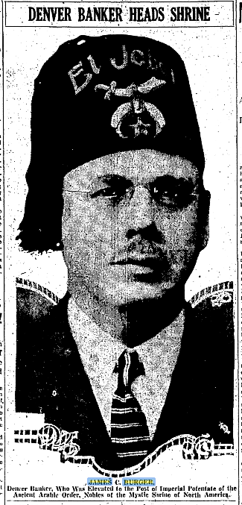
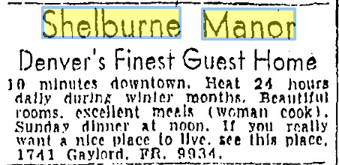
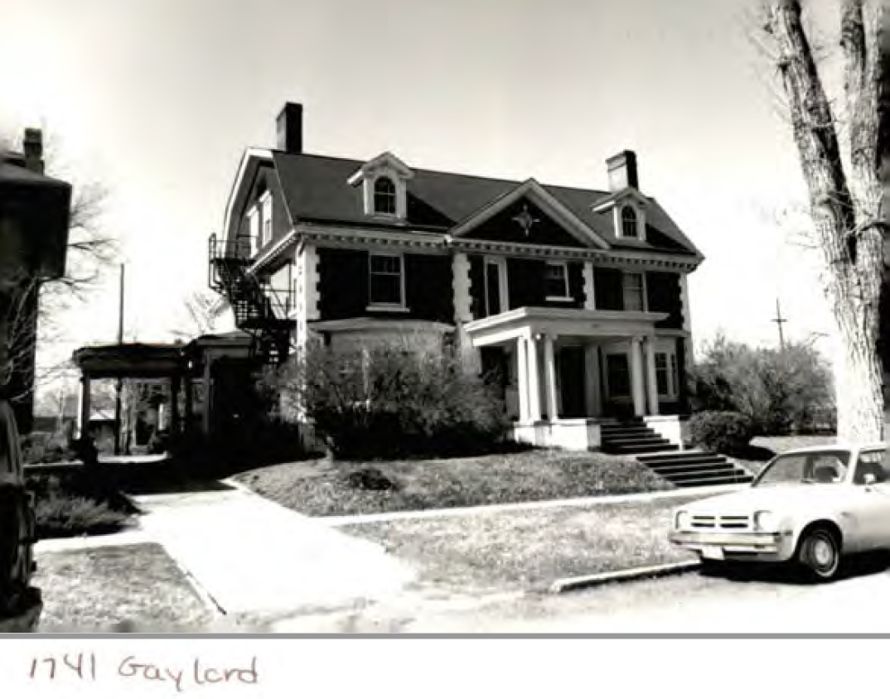
1741 N Gaylord

Slide 5
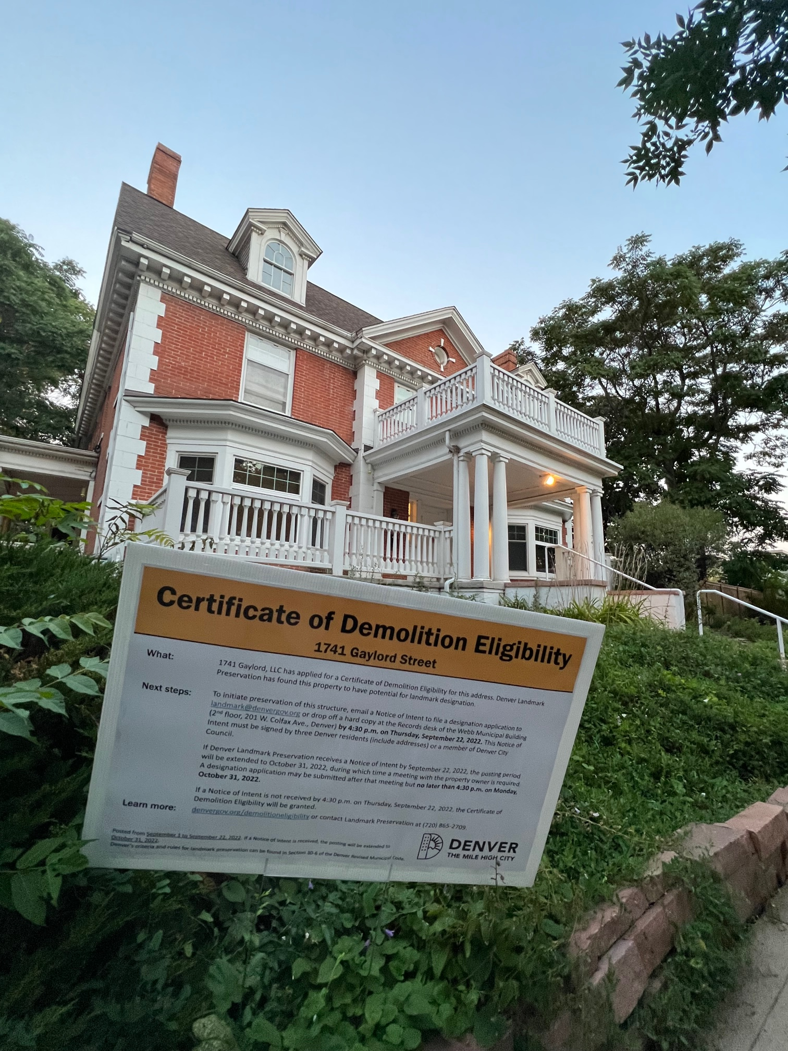
Organizing a Grassroots Effort
Social Media…Essential But No Panacea
Know The Process…Or know the people that do
Finding “Influencers”, Institutional & Individual
Traditional Media…Works Both Ways
Old Fashioned Canvassing…Very Important

Slide 6
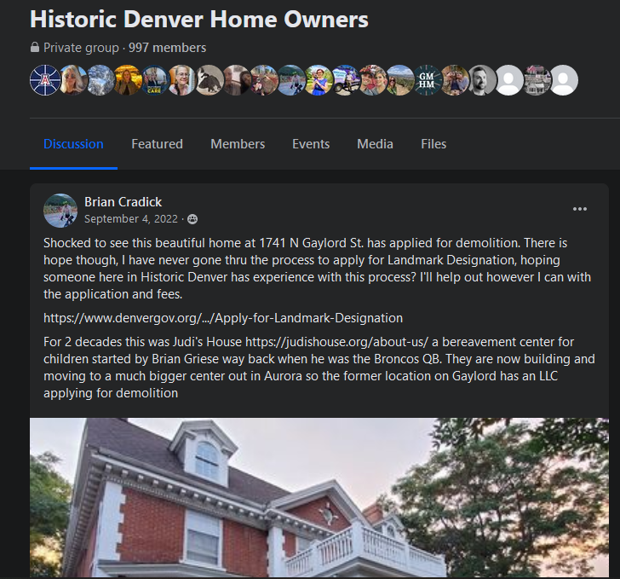
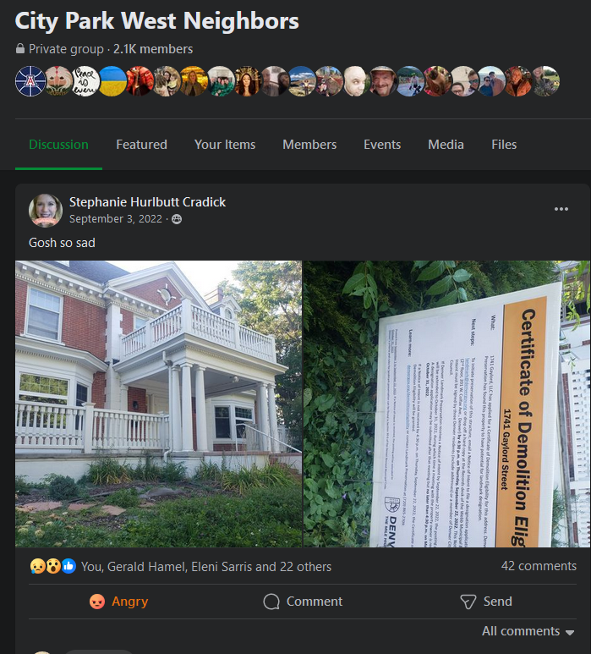
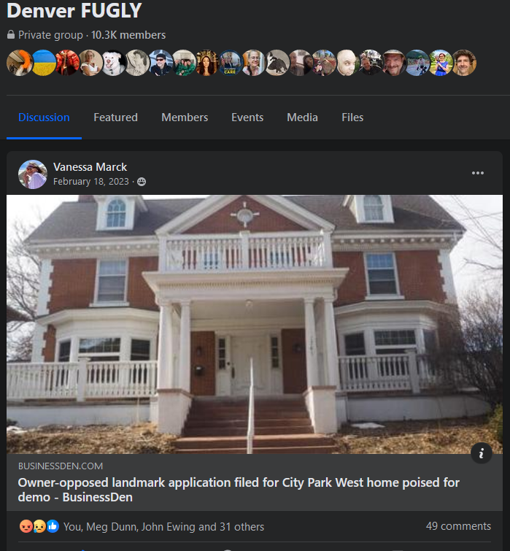
The Theoretical Impact of Social Media
Initial Awareness
Reach
Too Public (Email Is Your Friend)
Leaders and Everybody Else (Response vs Activism)

Slide 7
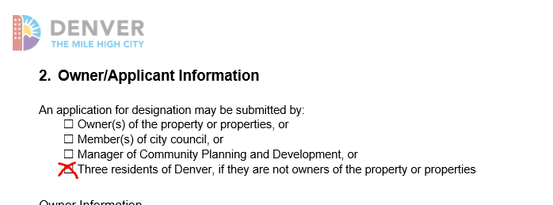
Knowing the Process
Non-owners can apply, great! Don’t look too closely at the process and approval rate
Time, Expertise & Money required, ie., the developer pays people to be there, you’re a volunteer
Mediation & Decision Points…Progress can stop at so many points
Powerful groups will be against you…most likely publicly
Politically elected officials make the decision…and they hate making these decisions in the spotlight

Slide 8
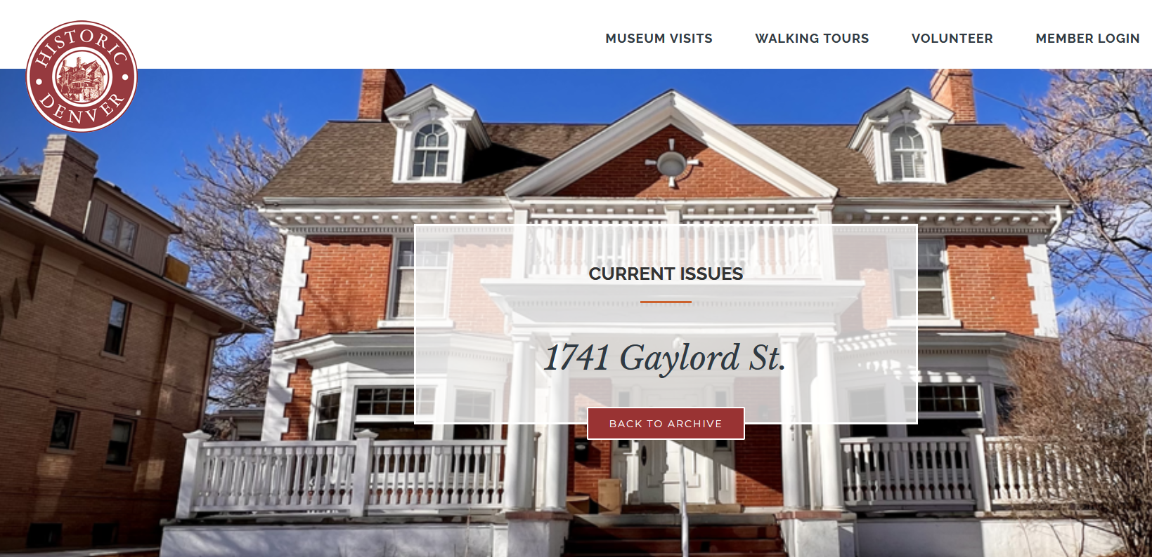
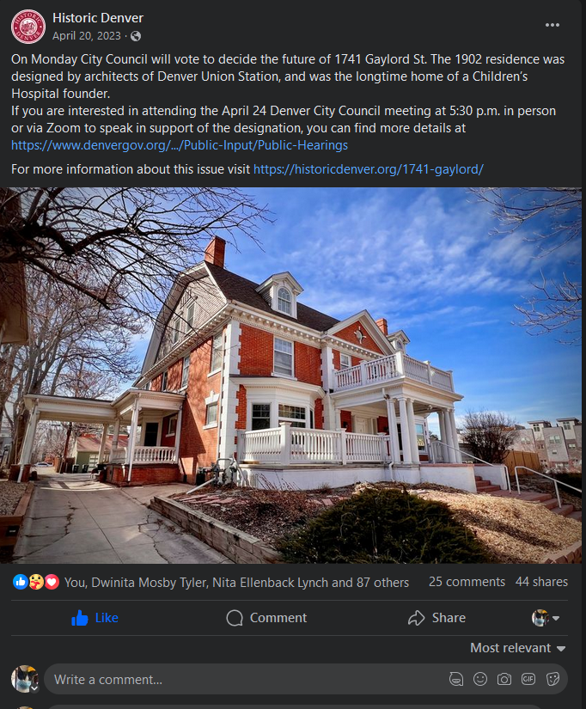
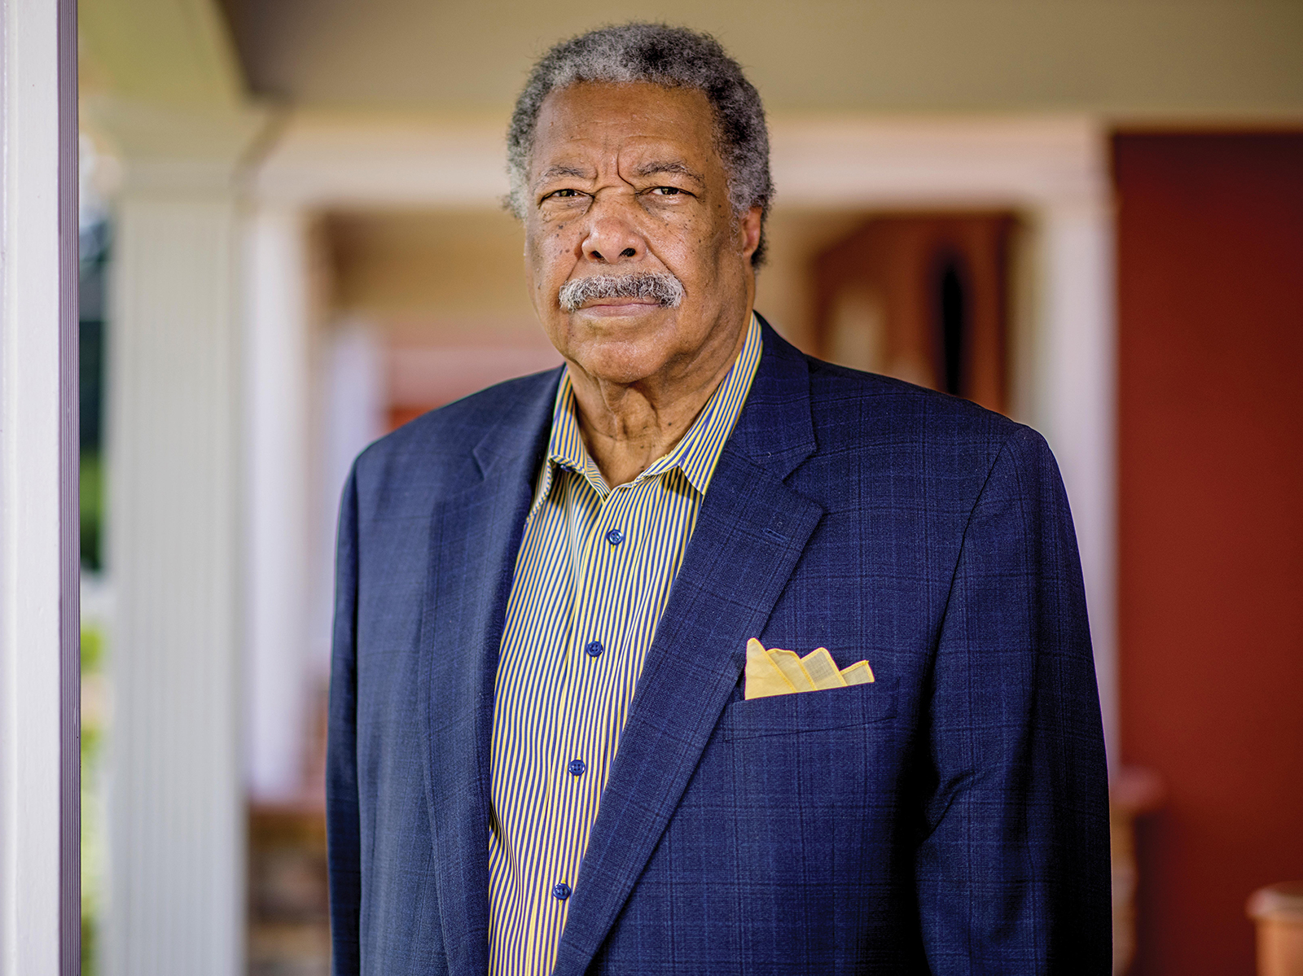
“Influencers”
Institutions vs Individuals…both are important
“Who You Know vs What You Know” both have a role

Slide 9
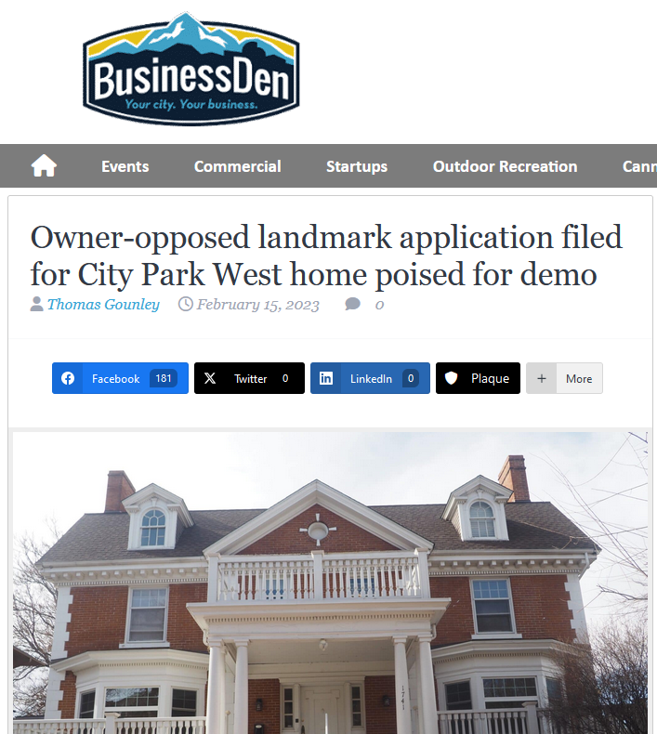
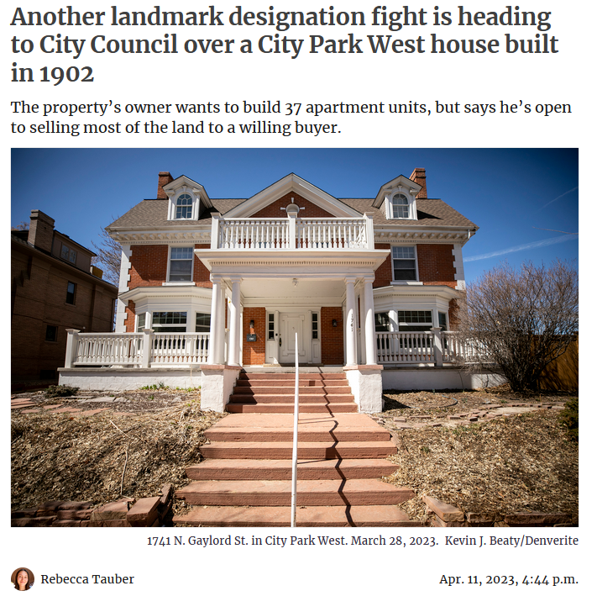
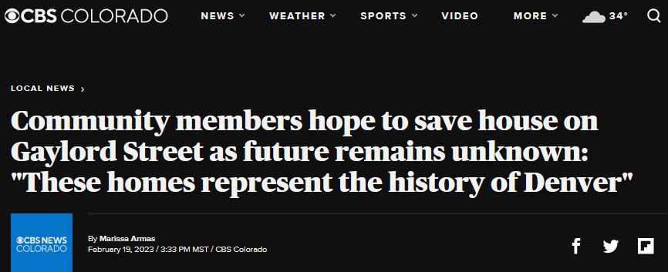
The Traditional Media
Denver media love “owner-opposed” stories so they’ll reach out…
Initially. “Both Sides” dictates most of their coverage
The “Institutional” friends are critical for getting traditional media to continue to pay attention
Payoff in terms of attention is good and bad.
Good = reach more potential supporters.
Bad = developer/real estate lobbying groups with money and professional PR people will work against you (we again were very lucky)

Slide 10
Skillset Diversity or How to Run A Campaign
To “win”, remember the word “Constituency”. The house needs you to build it one
Street canvassing, flyering have huge impact
Network constantly with new contacts from social/traditional media outreach—take advantage of surprise contacts
A canvasser, a political outreach(er), a social media manager, a correspondence manager, a graphics person, a media contact person, all needed
Don’t be shy about asking for CC member’s time for a meeting—even if it’s “just”staff, oh yeah, you need a person comfy doing that
Time & Money always key

Slide 11
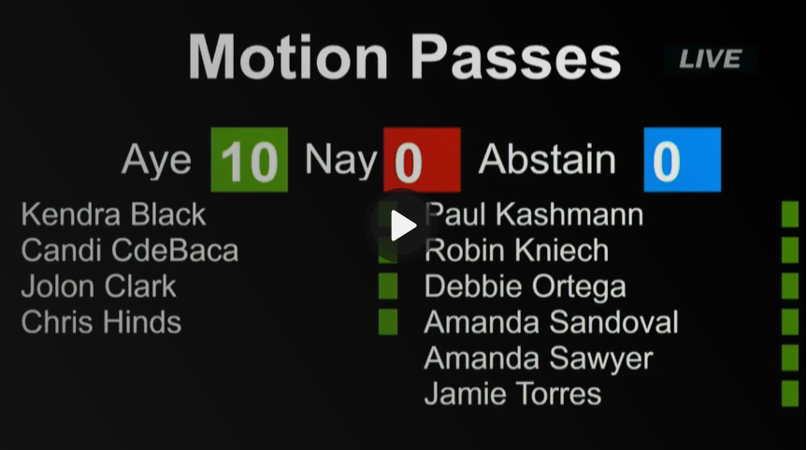
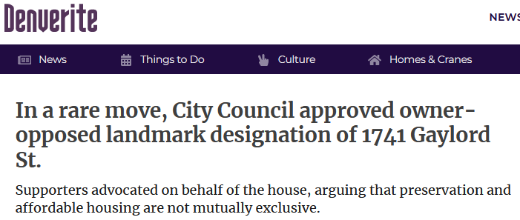
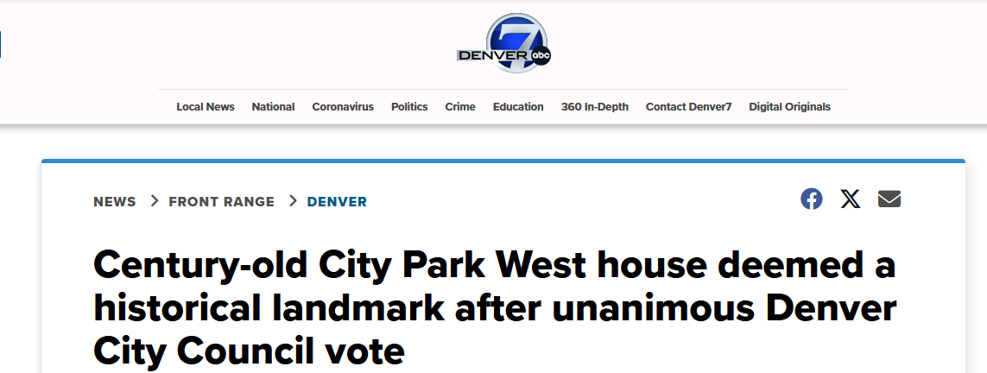
End Results and Takeaways
Equation: Time + Money + Expertise = Constituency
Constituency Building Unprecedented
Six Registered Neighborhood Organizations, 150+ separate support letters (that’s massive by normal standards)
Former Mayor Webb
Former Exec VP of Children’s Hospital
Historic Denver
Use City planning documents and statements to your advantage,. i.e., adaptive reuse, sustainability
Tailor your messaging with opposition messaging in mind.
Get people to hearings, be political

